Slide 1
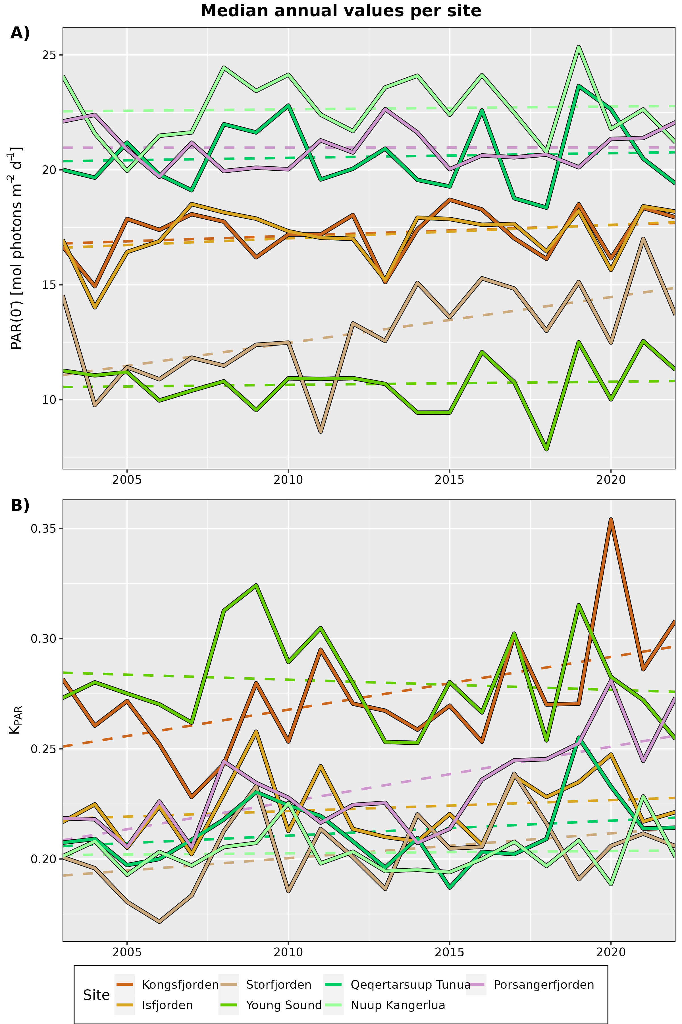

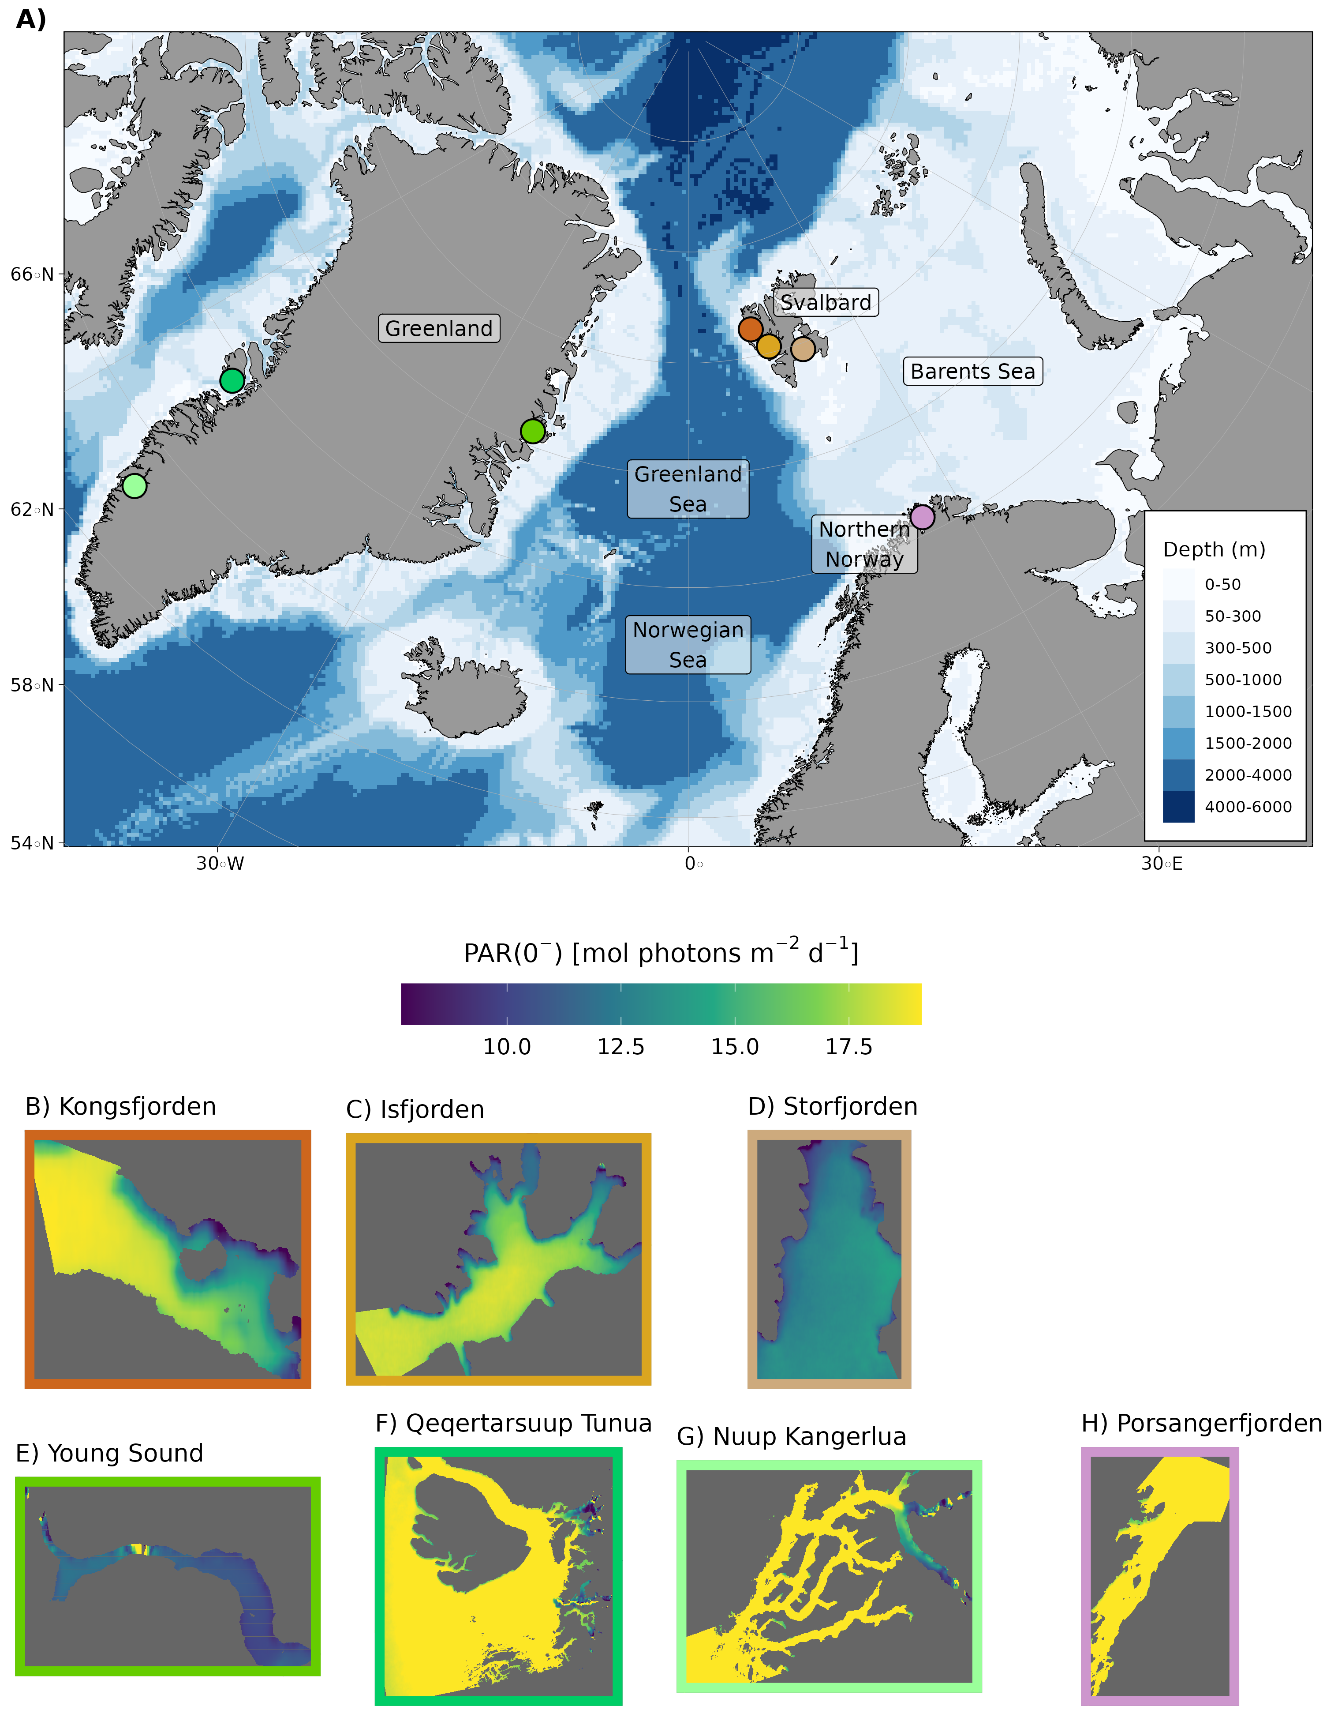
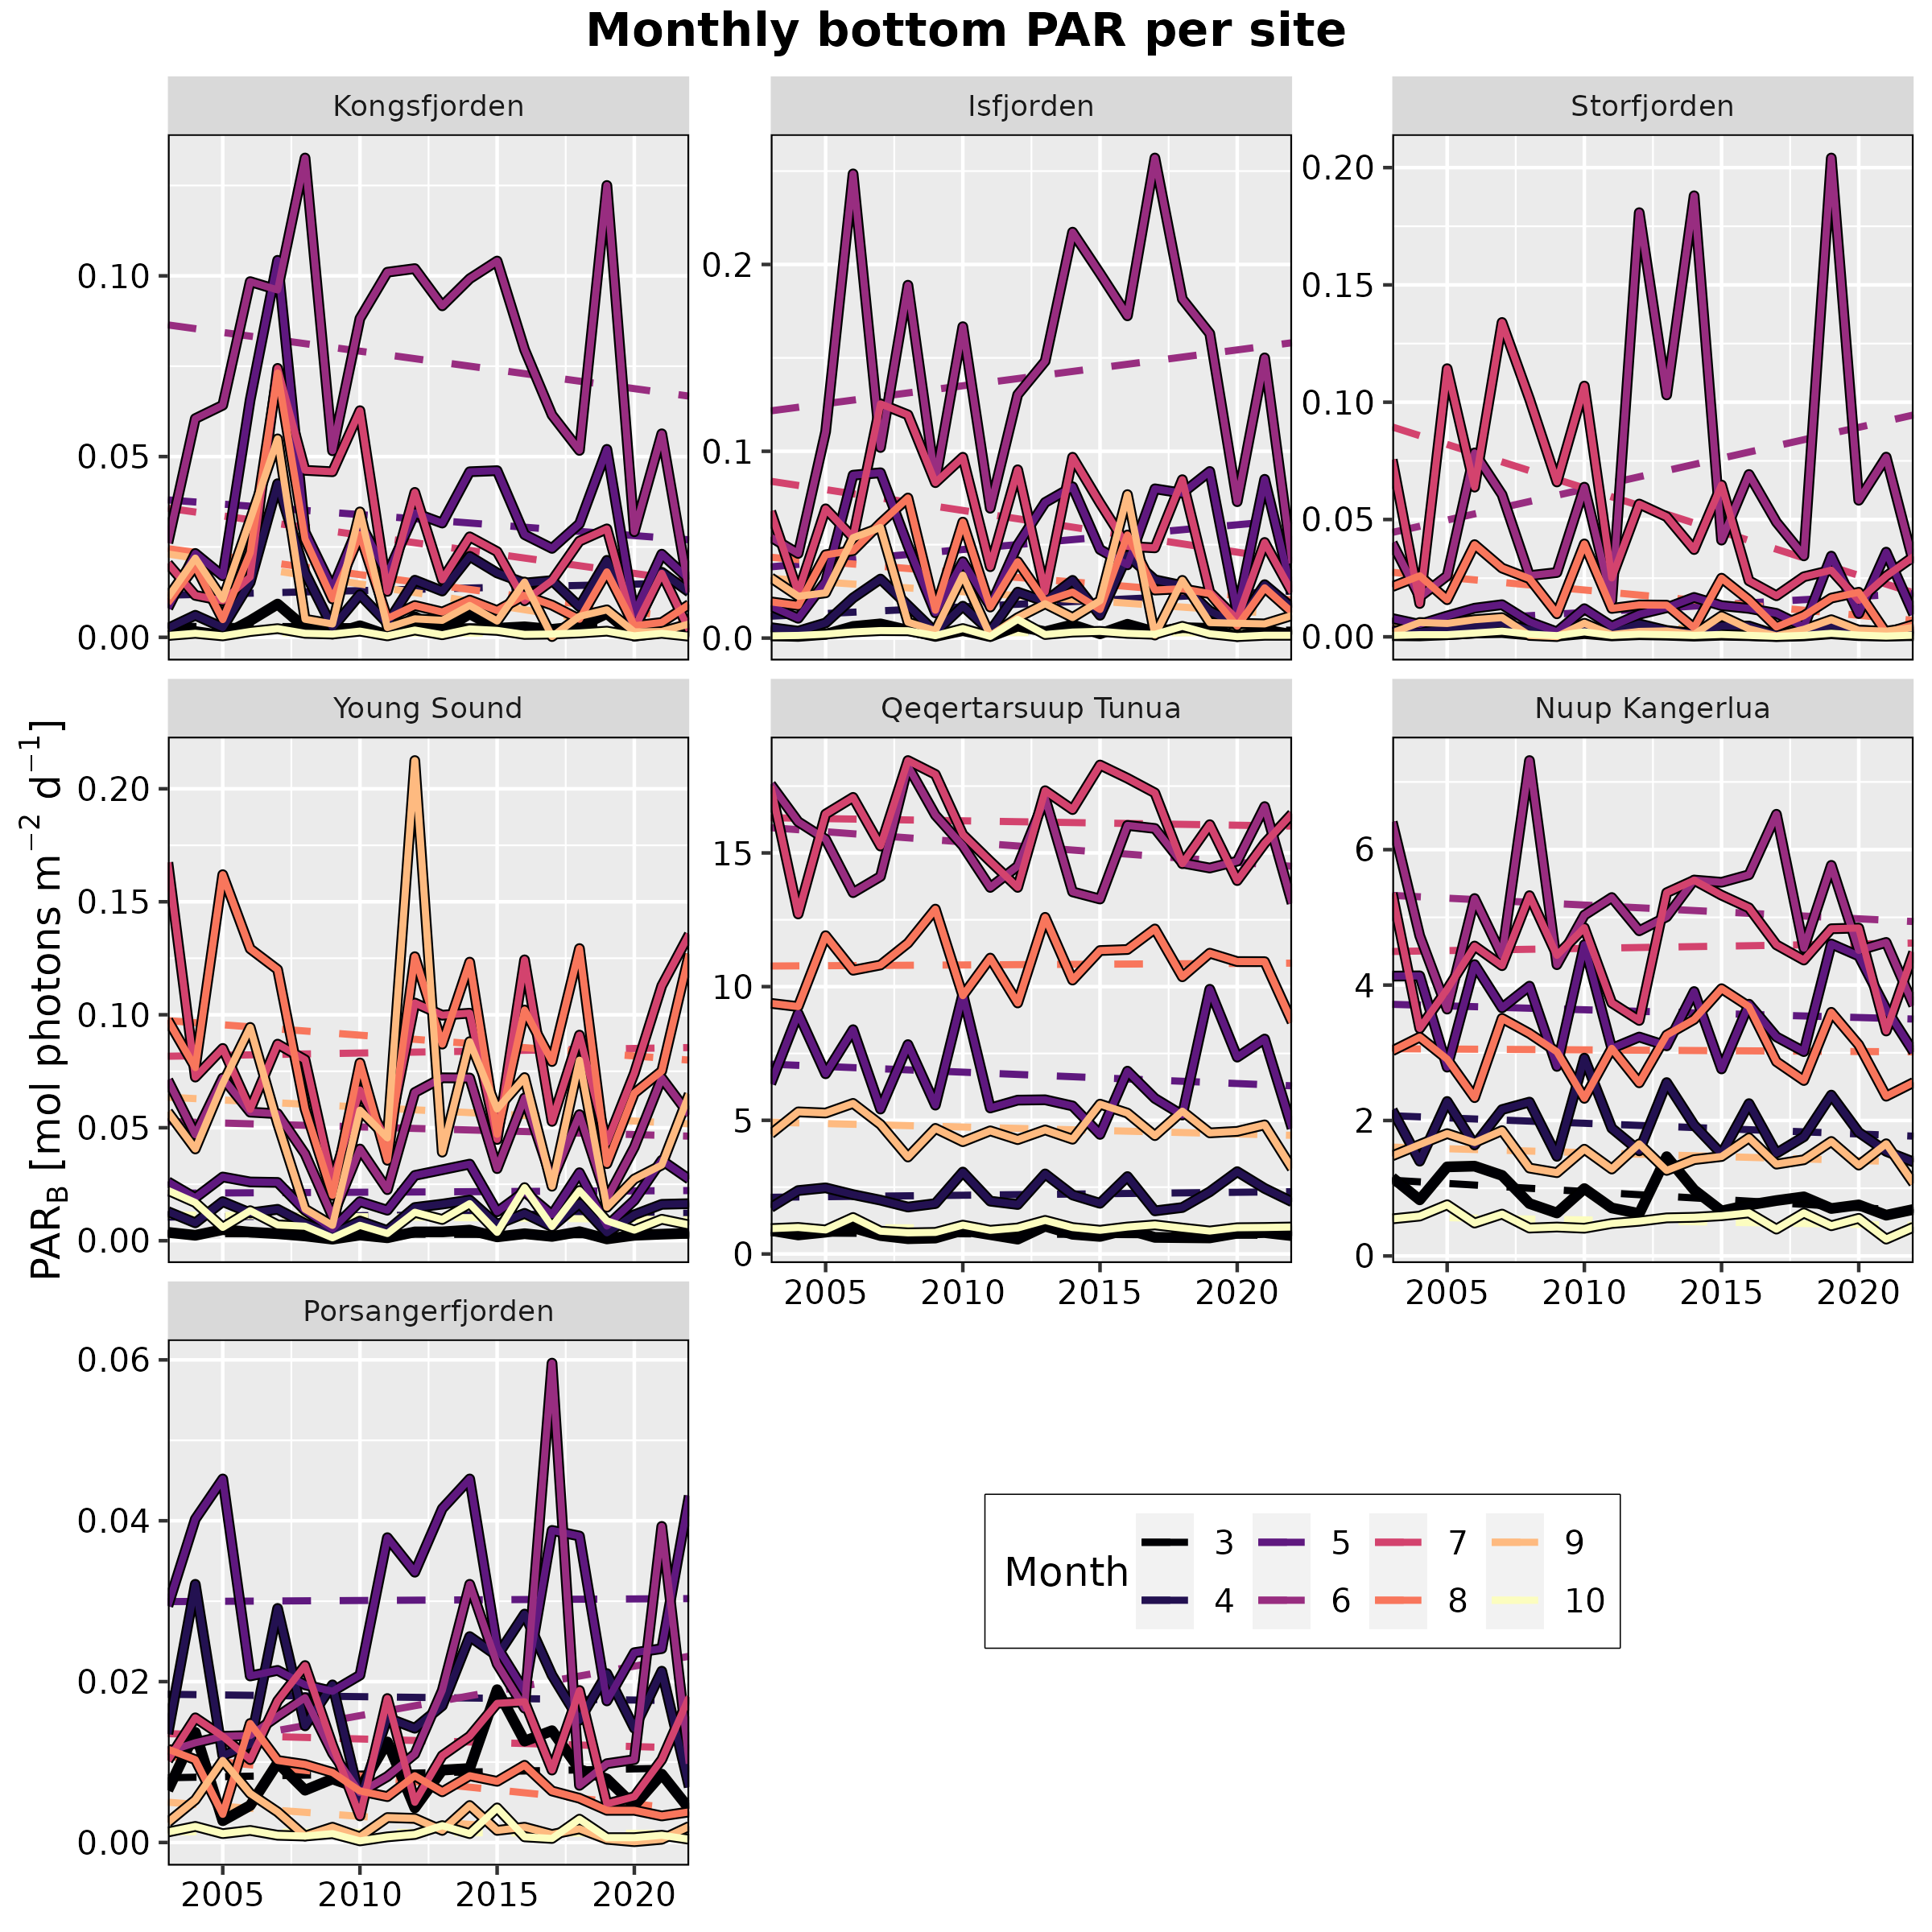
FjordLight
A bottom light dataset for the FACE-IT study sites
Scan Me!
Robert Schlegel¹, Bernard Gentili¹, Jean-Pierre Gattuso^{1,2}
Summary
There is a known lack of data explaining the light conditions within Arctic fjords. While some data do exist, they are naturally limited in time and space due to the difficulty of installing underwater devices, maintaining them, and ultimately retrieving the data. In order to address this issue the FjordLight dataset was created (Fig 1). This dataset contains surface PAR (photosynthetically available radiation; PAR(0⁻)), the extinction coefficient of PAR through the water column (k_{PAR}) and PAR at the seafloor (PAR_{B}) from 2003-2022 for the months of March to October. It also provides the P-functions for the coastal (200 m) and shallow (50 m) portions of the fjords, which show the proportion of the seafloor receiving at least a certain amount of PAR_{B} (e.g. Gattuso et al. 2020). PAR(0⁻) and k_{PAR} are available as global averages, monthly climatologies (e.g. 8 total values), and annual mean values (Fig 2). All of these values are provided for PAR_{B}, as well as time series of monthly averages from 2003-2022 (Fig 3).
Fig. 2 Time series of the average annual A) surface PAR (PAR(0⁻)) and B) extinction coefficient (k_{PAR}) for each of the 7 FACE-IT study sites from 2003-2022. Dashed lines show linear trend.
Fig. 3 Time series of the average monthly bottom PAR (PAR_{B}) for each of the 7 FACE-IT study sites from 2003-2022. Dashed lines show linear trend.
Material and Methods
The dataset presented here is created from retrievals of the visual surface of the ocean using MODIS-Aqua Level-1A (L1A), which is then processed to Level-2 via SeaDAS v8. From this, the algorithm from Singh et al. (2022) is used to determine PAR(0⁻) and k_{PAR}. With these two values, one then uses the highest resolution bathymetry products available (50-200 m) to calculate PAR_{B}. All data are then interpolated to the highest resolution grid of 50 m pixels.
Fig. 1 A) Map of the EU Arctic showing the location of the 7 FACE-IT study sites. B-H) The global surface PAR (PAR(0⁻)) for each of the seven sites. Note that differences in PAR(0⁻) are generally due to differences in sea ice cover.
¹ Sorbonne University, CNRS, Laboratoire d’Océanographie de Villefranche, Villefranche-sur-mer, France
² Institute for Sustainable Development and International Relations (IDDRI-Sciences Po), Paris, France
References
- Singh, R. K., Vader, A., Mundy, C. J., Søreide, J. E., Iken, K., Dunton, K. H., Castro de la Guardia, L., Sejr, M. K., & Bélanger, S. (2022). Satellite-Derived Photosynthetically Available Radiation at the Coastal Arctic Seafloor. Remote Sensing, 14(20), Article 20. https://doi.org/10.3390/rs14205180
- Gattuso, J.-P., Gentili, B., Antoine, D., & Doxaran, D. (2020). Global distribution of photosynthetically available radiation on the seafloor. Earth System Science Data, 12(3), 1697–1709. https://doi.org/10.5194/essd-12-1697-2020

